Slide 1
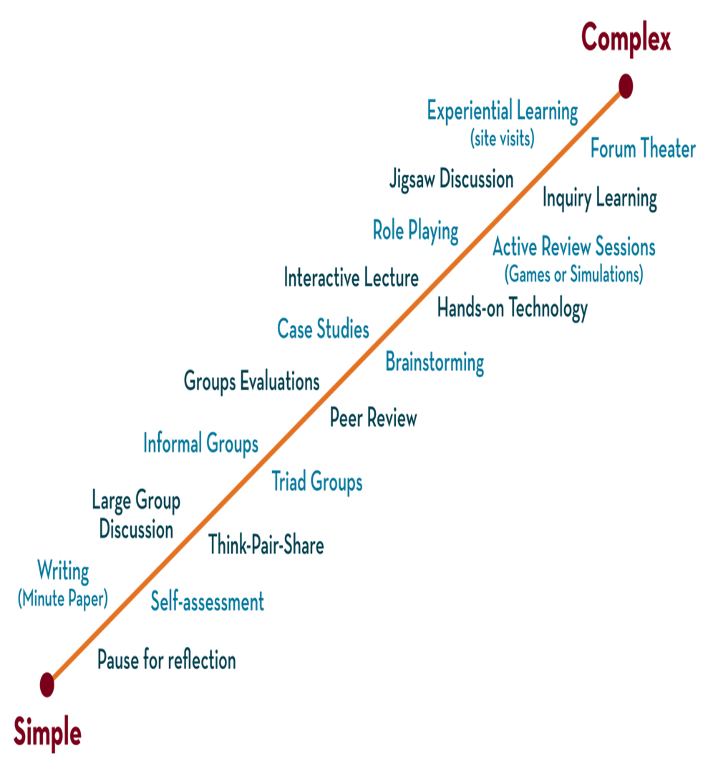

Department of CSE
DESIGN AND ANALYSIS OF ALGORITHMS
24CS2203
Topic:
Huffman Coding
Greedy Method

Slide 2
Encoding and Compression of Data
Compression:
  Data Compression, shrinks down a String so that it takes up less space. This is desirable for data storage and data communication.
  Encoding means converting the String into Binary codes
Decompression:
In the decompression we convert the Binary codes into the Original string.

Slide 3
Fixed and Variable Length Code
Fixed length code:
If every word in the code has the same length, the code is called a fixed-length code, or a block code.
Advantage | Disadvantage
Access is fast because the computer knows where each Word starts | Using Fixed length records, the records are usually larger and therefore need more storage space and are slower to transfer

Slide 4
Fixed and Variable Length Code
Variable length code:
Variable-length codes can perform significantly better as frequent characters are given short code words, while infrequent characters get longer code words.
Advantage | Disadvantages
Variable-length codes over fixed length is short codes that can be given to characters that occur frequently. | Where a character ends and another begins, difficult to identify.

Slide 5
Prefix Property
A code has the prefix property, code assigned to one character is not the prefix of code assigned to any other character.
Example:
01001101100010
R S T Q P T
000 is not a prefix of 11, 01, 001, or 10
11 is not a prefix of 000, 01, 001, or 10 ….
Symbol | Code
P | 000
Q | 11
R | 01
S | 001
T | 10

Slide 6
Huffman Coding
Developed by David Huffman in 1951
Huffman Coding is a famous Greedy Algorithm.
It is used for the lossless compression of data.
It uses variable length encoding.
It assigns variable length code to all the characters.
The code length of a character depends on how frequently it occurs in the given text.
The character which occurs most frequently gets the smallest code.
The character which occurs least frequently gets the largest code.
It is also known as Huffman Encoding.
Huffman Coding implements a rule known as a prefix rule.
This is to prevent the ambiguities while decoding.

Slide 7
Major steps in Huffman Coding
There are two major steps in Huffman Coding-
Building a Huffman Tree from the input characters.
Assigning code to the characters by traversing the Huffman Tree.
Notes:
An Introduction to Huffman Coding
March 21, 2000
Mike Scott

Slide 8
Huffman Tree
The steps involved in the construction of Huffman Tree are as follows-
Step-01:
Create a leaf node for each character of the text.
Leaf node of a character contains the occurring frequency of that character
Step-02:
Arrange all the nodes in increasing order of their frequency value.
Notes:
An Introduction to Huffman Coding
March 21, 2000
Mike Scott

Slide 9
Step-03:
Considering the first two nodes having minimum frequency
Create a new internal node.
The frequency of this new node is the sum of frequency of those two nodes.
Make the first node as a left child and the other node as a right child of the newly created node.
Step-04:
Keep repeating Step-02 and Step-03 until all the nodes form a single tree.
The tree finally obtained is the desired Huffman Tree.
Notes:
An Introduction to Huffman Coding
March 21, 2000
Mike Scott

Slide 10
Sample
  Message: aabacb
Notes:
An Introduction to Huffman Coding
March 21, 2000
Mike Scott

Slide 11
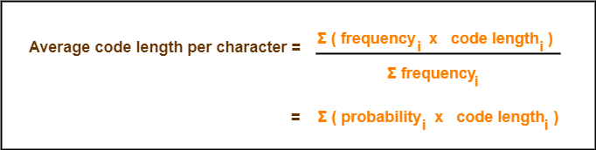
Formulae
The following 2 formulas are important to solve the problems based on Huffman Coding-
Formula-01:
Formula-02:
Total number of bits in Huffman encoded message
= Total number of characters in the message x Average code length per character
= ∑ ( frequency_{i} x Code length_{i} )
Notes:
An Introduction to Huffman Coding
March 21, 2000
Mike Scott

Slide 12
Example
Problem-
A file contains the following characters with the frequencies as shown. If Huffman Coding is used for data compression, determine-
Huffman Code for each character
Average code length
Length of Huffman encoded message (in bits)
Notes:
An Introduction to Huffman Coding
March 21, 2000
Mike Scott

Slide 13
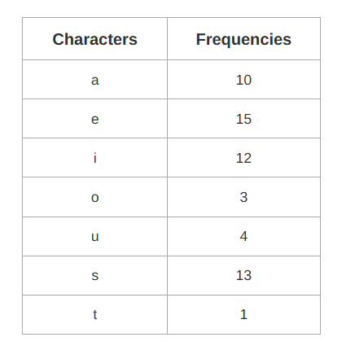
Notes:
An Introduction to Huffman Coding
March 21, 2000
Mike Scott

Slide 14

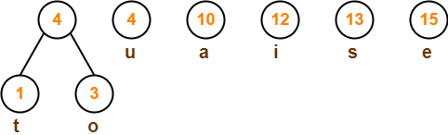
First let us construct the Huffman Tree.
Huffman Tree is constructed in the following steps-
Step-01:
Step-02:
Notes:
An Introduction to Huffman Coding
March 21, 2000
Mike Scott

Slide 15
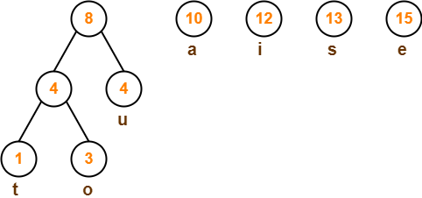
Step-03:
Notes:
An Introduction to Huffman Coding
March 21, 2000
Mike Scott

Slide 16
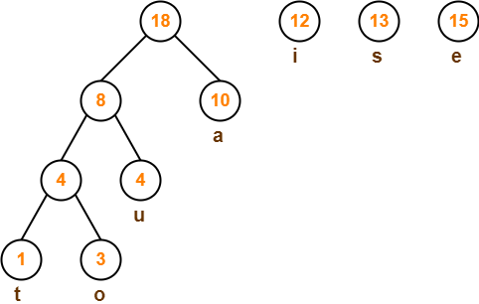
Step-04:

Slide 17
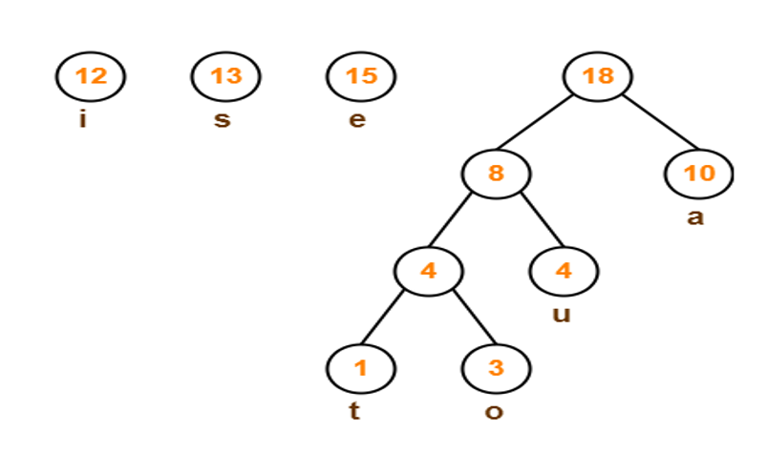
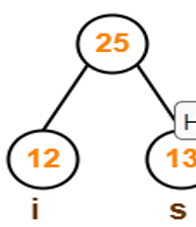
Step-05:

Slide 18
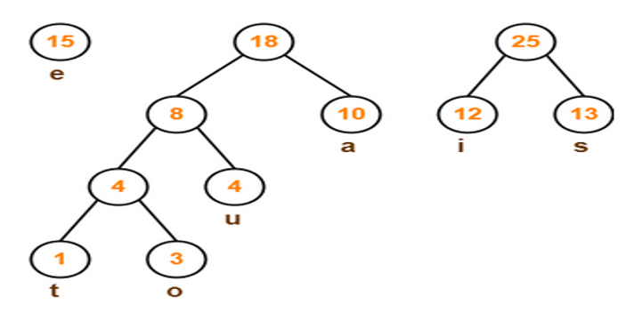

Slide 19
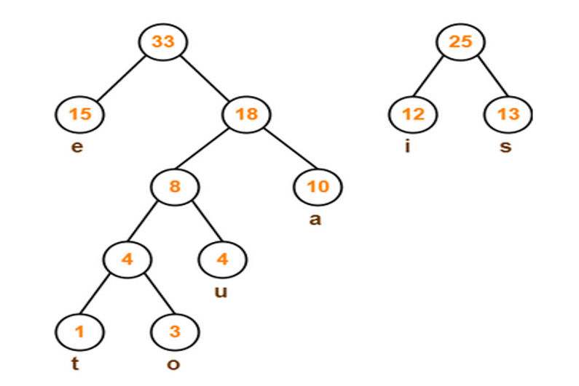
Step-06:

Slide 20
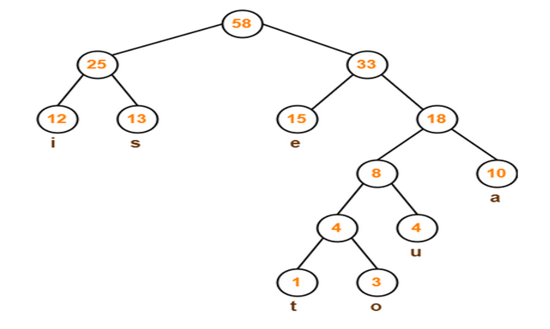
Step-07:

Slide 21
Now,
We assign weight to all the edges of the constructed Huffman Tree.
Let us assign weight ‘0’ to the left edges and weight ‘1’ to the right edges
Rule
If you assign weight ‘0’ to the left edges, then assign weight ‘1’ to the right edges.
If you assign weight ‘1’ to the left edges, then assign weight ‘0’ to the right edges.
Any of the above two conventions may be followed.
But follow the same convention at the time of decoding that is adopted at the time of encoding.
Notes:
An Introduction to Huffman Coding
March 21, 2000
Mike Scott

Slide 22
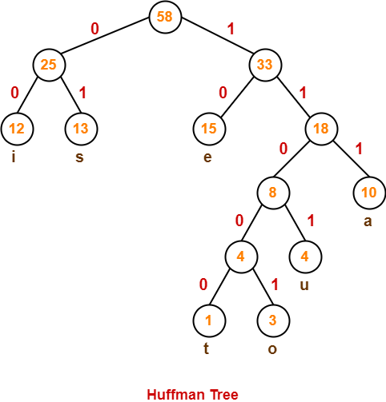
Notes:
An Introduction to Huffman Coding
March 21, 2000
Mike Scott

Slide 23
Huffman Code fo each Character
To write Huffman Code for any character, traverse the Huffman Tree from root node to the leaf node of that character.
Following this rule, the Huffman Code for each character is-
a = 111
e = 10
i = 00
o = 11001
u = 1101
s = 01
t = 11000
From here, we can observe-
Characters occurring less frequently in the text are assigned the larger code.
Characters occurring more frequently in the text are assigned the smaller code.
Notes:
An Introduction to Huffman Coding
March 21, 2000
Mike Scott

Slide 24
Average Code Length
Using formula-01
Average code length
= ∑ ( frequency_{i} x code length_{i} ) / ∑ ( frequency_{i} )
= { (10 x 3) + (15 x 2) + (12 x 2) + (3 x 5) + (4 x 4) + (13 x 2) + (1 x 5) } / (10 + 15 + 12 + 3 + 4 + 13 + 1)
= 2.52
Notes:
An Introduction to Huffman Coding
March 21, 2000
Mike Scott

Slide 25
Length of Huffman Encoded Message
Using formula-02
Total number of bits in Huffman encoded message
= Total number of characters in the message x Average code length per character
= 58 x 2.52
= 146.16
≅ 147 bits
Notes:
An Introduction to Huffman Coding
March 21, 2000
Mike Scott

Slide 26
Applications
Huffman coding is a technique used to compress files for transmission
Uses statistical coding
  more frequently used symbols have shorter code words
Works well for text and fax transmissions
An application that uses several data structures

Slide 27
Home Work
Suppose a data file has the following characters and the frequencies. If huffman coding is used, calculate:
Huffman Code of each character
Average code length
Length of Huffman encoded data
Characters | Frequencies
A | 12
B | 15
C | 7
D | 13
E | 9

Slide 28
Home Work
Suppose a data file has the following characters and the frequencies. If huffman coding is used, calculate:
Huffman Code of each character
Average code length
Length of Huffman encoded data
Letter | Z | K | M | C | U | D | L | E
Frequency | 2 | 7 | 24 | 32 | 37 | 42 | 42 | 120

